Slide 1
PROJECT PRESENTATION & REPORT
(CMPE343)

Slide 2
MEMBERS
ZAKARIA EL MILKI (22321066): Observed library systems, created the ER-diagram and managed the DDL and DML files in order to visualize a library’s system.
MOHAMMED AMINE EL MAHDI (22323103) & IBRAHIM ALBADWI (22320651):Created queries, tested them and made the report by following the structure and by adding the relevant information.

Slide 3
INTRODUCTION
The following project implements a relational database for Ercan Airport, managing airplanes, technical staff, traffic controllers, hangar storage, and safety inspections. It ensures data integrity through complex relationships and foreign keys, supporting queries that help track aircraft maintenance, monitor technician expertise, analyze hangar occupancy, and manage airport operations efficiently.

Slide 4
OVERALL STRUCTURE
Employees (ssn (PK), full_name, address, union_membership_no, salary)
Technicians (ssn (PK/FK), rank)
TrafficControllers (ssn (PK/FK), last_exam_date)
PlaneModels (model_id (PK), manufacturer, capacity)
Airplanes (plane_reg_no (PK), model_id (FK))
Hangars (hangar_id (PK), location, capacity)
HangarLogs (log_id (PK), plane_reg_no (FK), hangar_id (FK), in_time, out_time)
TestTypes (test_id (PK), test_name, max_score)
Expertise (ssn (PK/FK), model_id (PK/FK))
TestRecords (event_id (PK), ssn (FK), plane_reg_no (FK), test_id (FK), test_date, hours_spent, score)

Slide 5
RELATIONSHIPS BETWEEN ENTITIES
Employees and Roles: Technicians and Traffic Controllers are specialized types of Employees (1:1).
Models and Airplanes: Each specific airplane belongs to one model, but a model can have many airplanes (1:N).
Expertise: Technicians are certified for specific plane models (N:N).
Hangar Tracking: An airplane is logged into a hangar for a specific duration (1:N).
Testing: Technicians use specific tests to check airplanes, creating a detailed record of the event.

Slide 6
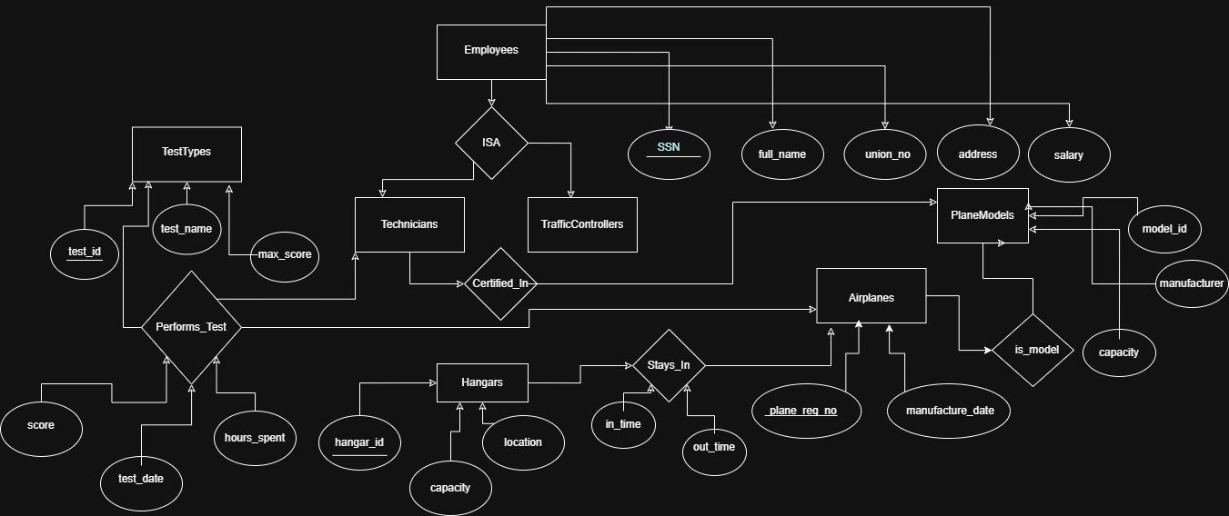
ENTITY RELATIONSHIP DIAGRAM (ERD)

Slide 7
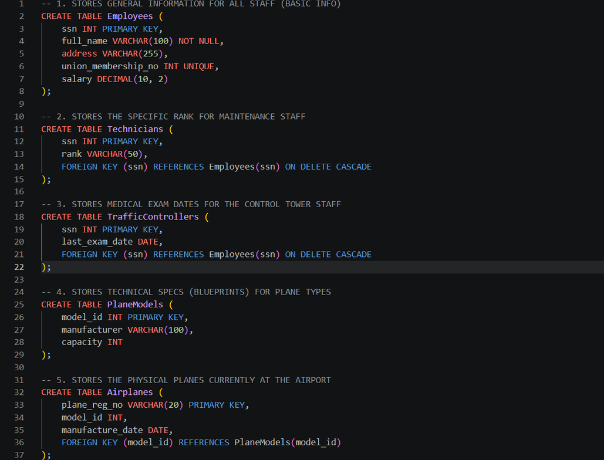
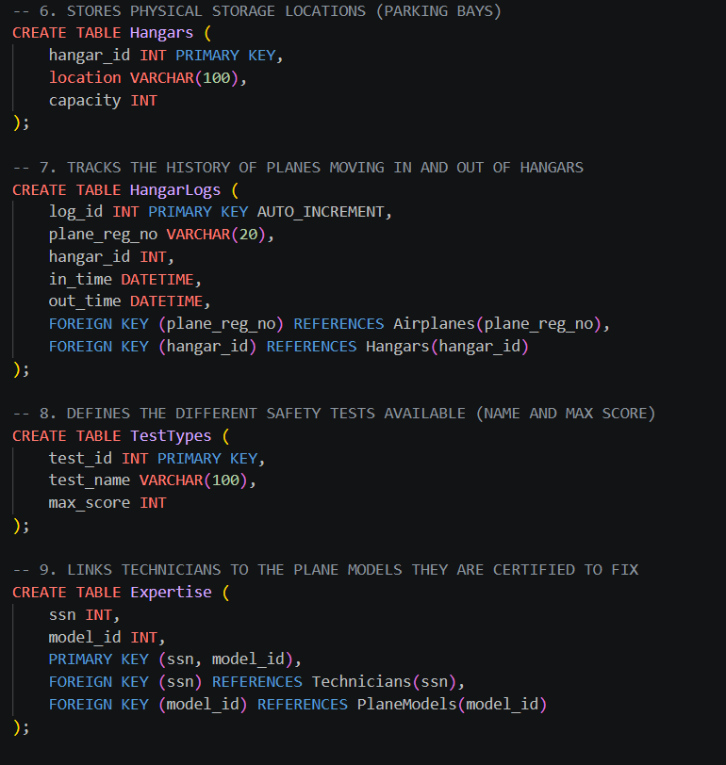
DDL ( MANAGING DATABASE AND TABLES)

Slide 8
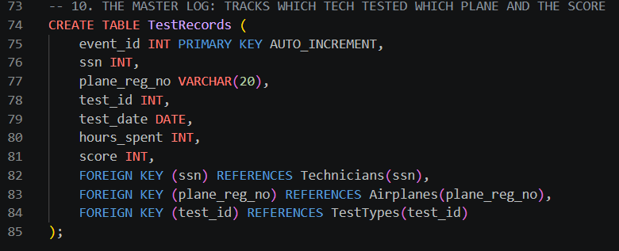

Slide 9
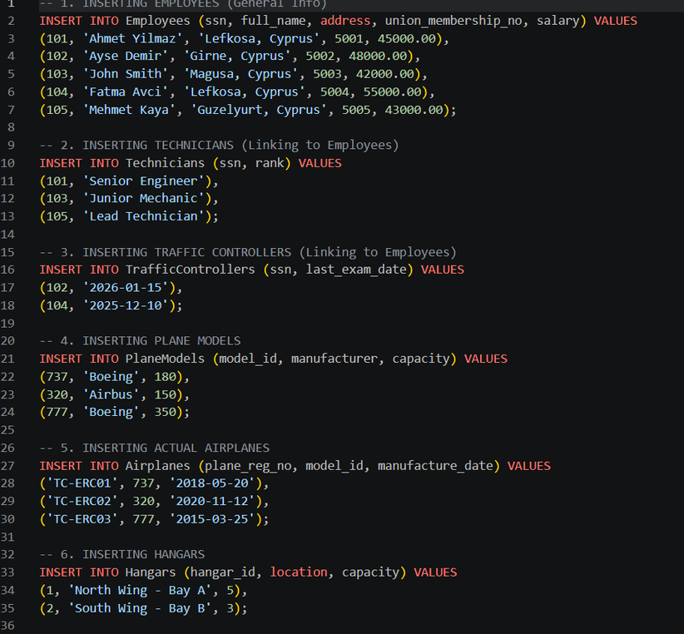
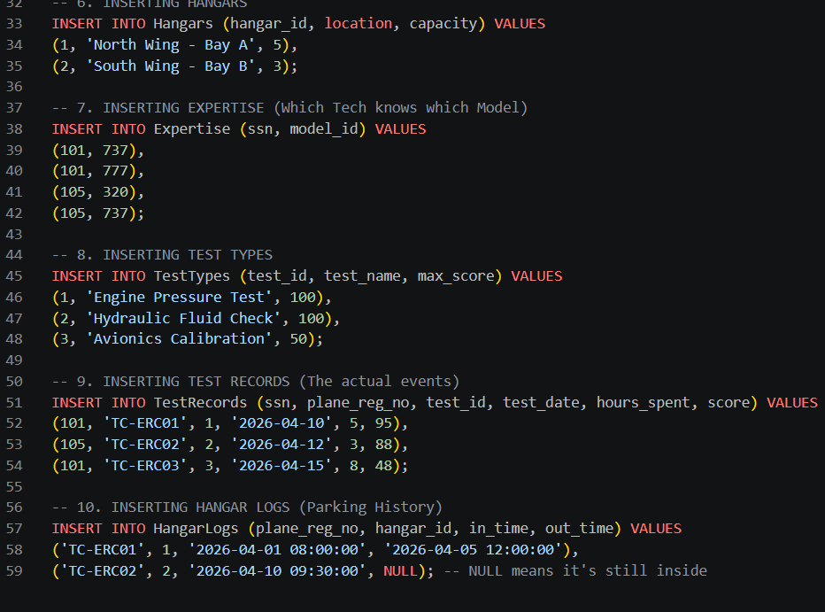
DML STATEMENTS

Slide 10
QUERIES
The following queries that will be displayed alongside with their output benefit much in filtering data in library database which outlines the important role of such techniques in facilitating the work and process of complex systems

Slide 11
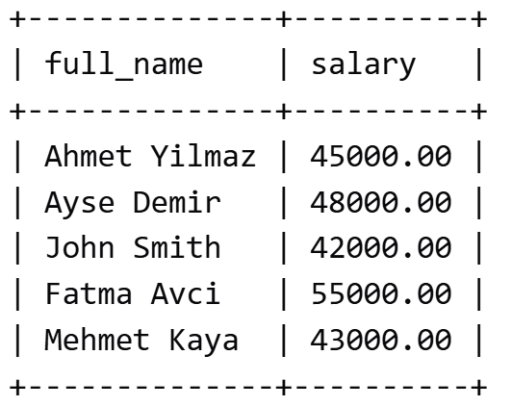
-- Q1: LIST ALL EMPLOYEES AND THEIR SALARIES
SELECT full_name, salary FROM Employees;

Slide 12
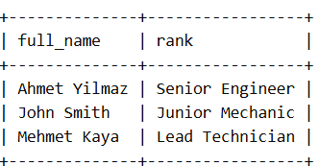
-- Q2: FIND ALL TECHNICIANS (JOINING EMPLOYEES AND TECHNICIANS)
SELECT E.full_name, T.rank
FROM Employees E
JOIN Technicians T ON E.ssn = T.ssn;

Slide 13
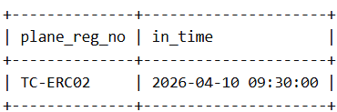
-- Q3: FIND PLANES CURRENTLY PARKED IN HANGAR 1 (WHERE OUT_TIME IS NULL)
SELECT plane_reg_no, in_time
FROM HangarLogs
WHERE hangar_id = 1 AND out_time IS NULL;

Slide 14
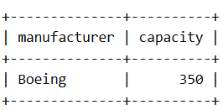
-- Q4: LIST PLANE MODELS WITH CAPACITY OVER 200 SEATS
SELECT manufacturer, capacity
FROM PlaneModels
WHERE capacity > 200;

Slide 15
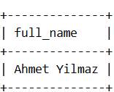
-- Q5: FIND ALL EXPERTS CERTIFIED ON THE 'BOEING 737'
SELECT E.full_name
FROM Employees E
JOIN Expertise EX ON E.ssn = EX.ssn
WHERE EX.model_id = 737;

Slide 16
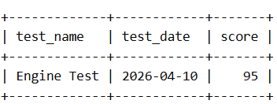
-- Q6: SHOW MAINTENANCE HISTORY FOR A SPECIFIC PLANE (TC-ERC01)
SELECT T.test_name, TR.test_date, TR.score
FROM TestRecords TR
JOIN TestTypes T ON TR.test_id = T.test_id
WHERE TR.plane_reg_no = 'TC-ERC01';

Slide 17
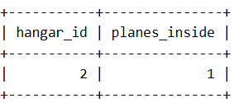
-- Q7: COUNT HOW MANY PLANES EACH HANGAR IS CURRENTLY HOLDING
SELECT hangar_id, COUNT(*) AS planes_inside
FROM HangarLogs
WHERE out_time IS NULL
GROUP BY hangar_id;

Slide 18
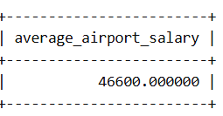
-- Q8: FIND THE AVERAGE SALARY OF ALL AIRPORT EMPLOYEES
SELECT AVG(salary) AS average_airport_salary FROM Employees;

Slide 19
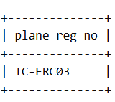
-- Q9: LIST PLANES THAT HAVE NEVER HAD A SAFETY TEST (CRITICAL FOR SAFETY)
SELECT plane_reg_no
FROM Airplanes
WHERE plane_reg_no NOT IN (SELECT plane_reg_no FROM TestRecords);

Slide 20
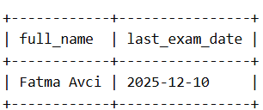
-- Q10: FIND TRAFFIC CONTROLLERS WHO HAVEN'T HAD AN EXAM SINCE 2025
SELECT E.full_name, TC.last_exam_date
FROM Employees E
JOIN TrafficControllers TC ON E.ssn = TC.ssn
WHERE TC.last_exam_date < '2026-01-01';

Slide 21
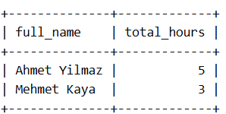
-- Q11: CALCULATE TOTAL HOURS SPENT ON TESTS BY EACH TECHNICIAN
SELECT E.full_name, SUM(TR.hours_spent) AS total_hours
FROM Employees E
JOIN TestRecords TR ON E.ssn = TR.ssn
GROUP BY E.full_name;

Slide 22
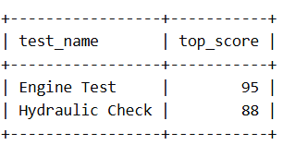
-- Q12: SHOW THE HIGHEST SCORE ACHIEVED ON EACH TYPE OF TEST
SELECT TT.test_name, MAX(TR.score) AS top_score
FROM TestTypes TT
JOIN TestRecords TR ON TT.test_id = TR.test_id
GROUP BY TT.test_name;

Slide 23
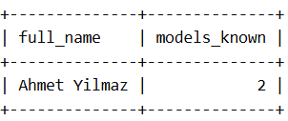
-- Q13: FIND TECHNICIANS WHO ARE EXPERTS IN MORE THAN 1 MODEL
SELECT E.full_name, COUNT(EX.model_id) AS models_known
FROM Employees E
JOIN Expertise EX ON E.ssn = EX.ssn
GROUP BY E.full_name
HAVING COUNT(EX.model_id) > 1;

Slide 24
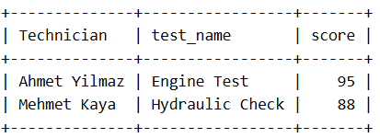
-- Q14: JOIN EMPLOYEES, TESTRECORDS, AND TESTTYPES (3-WAY JOIN)
SELECT E.full_name AS Technician, TT.test_name, TR.score
FROM Employees E
JOIN TestRecords TR ON E.ssn = TR.ssn
JOIN TestTypes TT ON TR.test_id = TT.test_id;

Slide 25
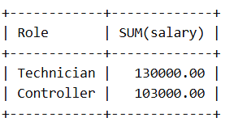
-- Q15: COMPARE TOTAL SALARY BUDGET: TECHNICIANS VS CONTROLLERS
SELECT 'Technician' AS Role, SUM(salary) FROM Employees WHERE ssn IN (SELECT ssn FROM Technicians)
UNION
SELECT 'Controller', SUM(salary) FROM Employees WHERE ssn IN (SELECT ssn FROM TrafficControllers);

Slide 26
CONCLUSION
The design and implementation of the Ercan Airport database successfully demonstrate how a relational model can streamline complex aviation operations. By organizing data into ten normalized tables, we have created a system that ensures data integrity while providing deep insights into employee management, technician certifications, and aircraft maintenance history. The 15 SQL queries developed for this project serve as powerful management tools, allowing for real-time tracking of hangar capacity and safety test performance. Overall, this database provides a scalable and robust foundation that can be easily expanded to include flight scheduling and passenger services in the future.

Slide 27
THANK YOU
Asst. Prof. Dr. Yasemin BAY

